Slide 1
Toumba. Lefkandi. Eubeea.
Dark Age

Slide 2
Theoretical approach
Snodgrass – depopulare, pastorialism, izolare, stratificare socială modestă (archae record case), sec. VIII-revoluție structurală
contra

Slide 3
Theoretical approach
Ian Morris, Burial and Ancient Society, Cambridge, 1987.
burials ‘as the material remains of self-representations of social structure through the agency of ceremony’ (Morris 1987, 8).
‘archaeologically visible’ formal burials, resulting from conspicuous funerary rituals, reflect the ‘social persona’ of the dead, namely ‘a selection of the various social identities held by the deceased among the living’ (Morris 1987, 37) ‘. . . and the choice of roles to be given signification in the funeral is determined by the society’s organizational principles’

Slide 4
Infos
Amplasare – Lefkandi, Eubeea
Datare-sec. X
Descriere
http://lefkandi.classics.ox.ac.uk/Toumba.html

Slide 5
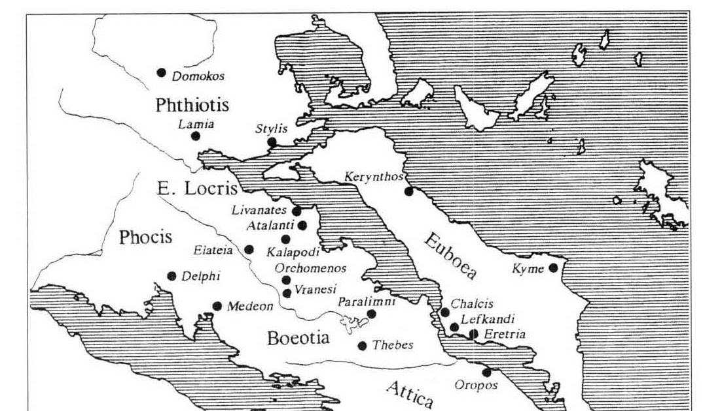

Slide 6
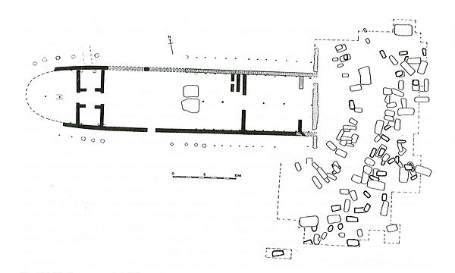

Slide 7
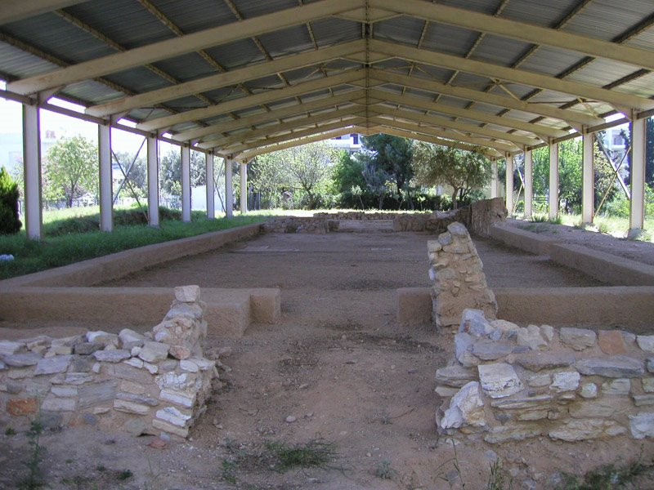

Slide 8
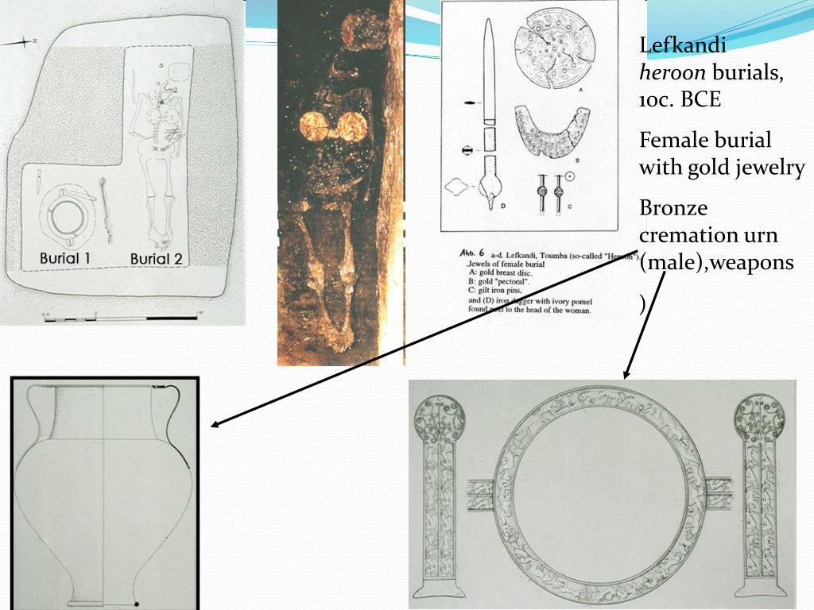

Slide 9
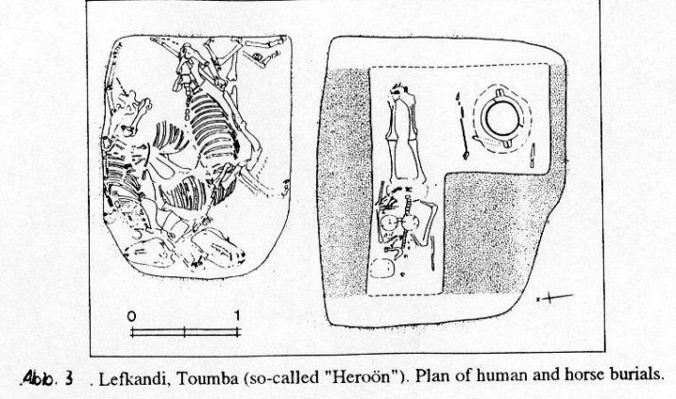

Slide 10
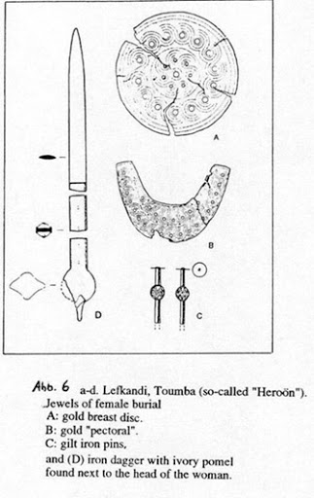

Slide 11
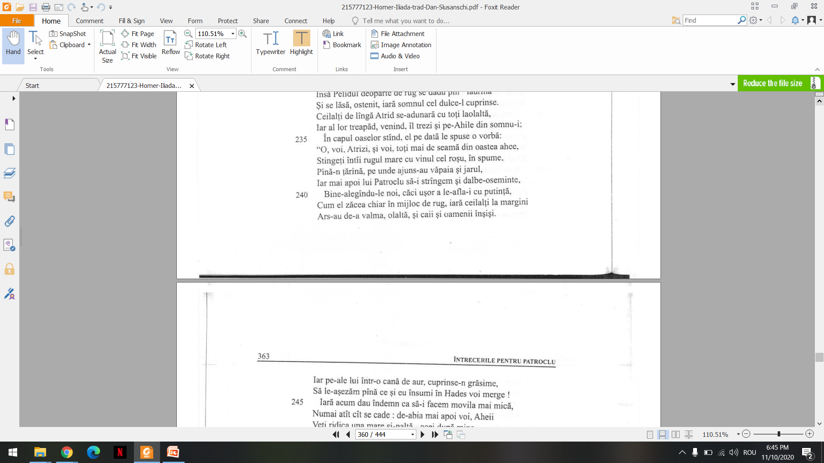

Slide 12
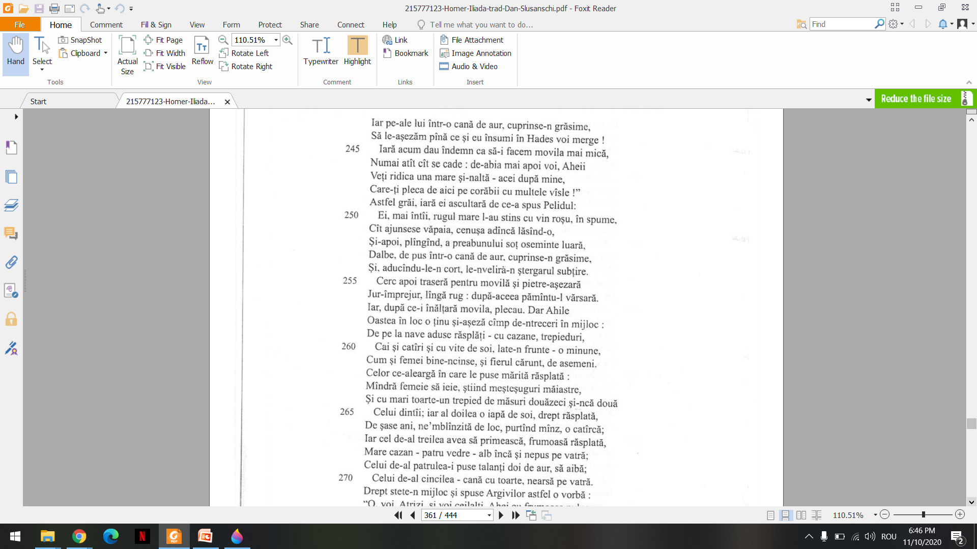

Slide 13
Importanță
Contra vechilor teorii despre Dark Age
Ritualul eroic – comparație Homer (Patroclu)
Heroon-ul și restul necropolei
Cultul eroilor
Ce sunt eroii?

Slide 14
Toumba caracter excepțional
Meanwhile, at the end of the historical processes under consideration here, during the final phase of the formation of the archaic Greek world, in a large part of the Aegean we find ideologically egalitarian citizen-communities dominated by an aristocratic élite. Since there was most likely no social revolution along the way, we must assume that the free peasants were an important social group throughout the Dark Ages, playing some political role in their communities and whose means of subsistence and social position were tied to tilling their own land. A basic political principle of the archaic period, according to which only a landowner could be a citizen,44 also implies the significance of minor landed property in the previous era. A radical turn to pastoralism (Snodgrass) in the Dark Ages simply does not fit with this picture.
Archaeological material clearly points to this region’s isolation from the outside world (indicated, at least in part, by the scarcity of imports in burials) and the low level of social diversification within the investigated communities (modest houses with only one chamber, minor differences between houses within the individual settlements, etc.). There are several sites that stand out from this general picture, indicating that both the contacts of the local élites with the outside world and their position within the communities may have been stronger. In particular, I am thinking about the testimony of the ‘Heroon of Lefkandi’.

